Slide 1
Bottleneck-Gated Segmentation Network
Efficient Conditional Decoder Activation for Semantic Segmentation
Bhoumik Patidar
22110049

Slide 2
Problem Statement
Targeting large-scale semantic segmentation workloads.
Dataset‑Level Sparsity: Regions of interest (ROIs) often occupy only a small fraction of total patches across large image datasets, making most decoder invocations superfluous.
Uniform Decoder Processing: Off‑the‑shelf encoder–decoder architectures apply identical decoding operations to every spatial patch, regardless of semantic content
Redundant Compute & Latency

Slide 3
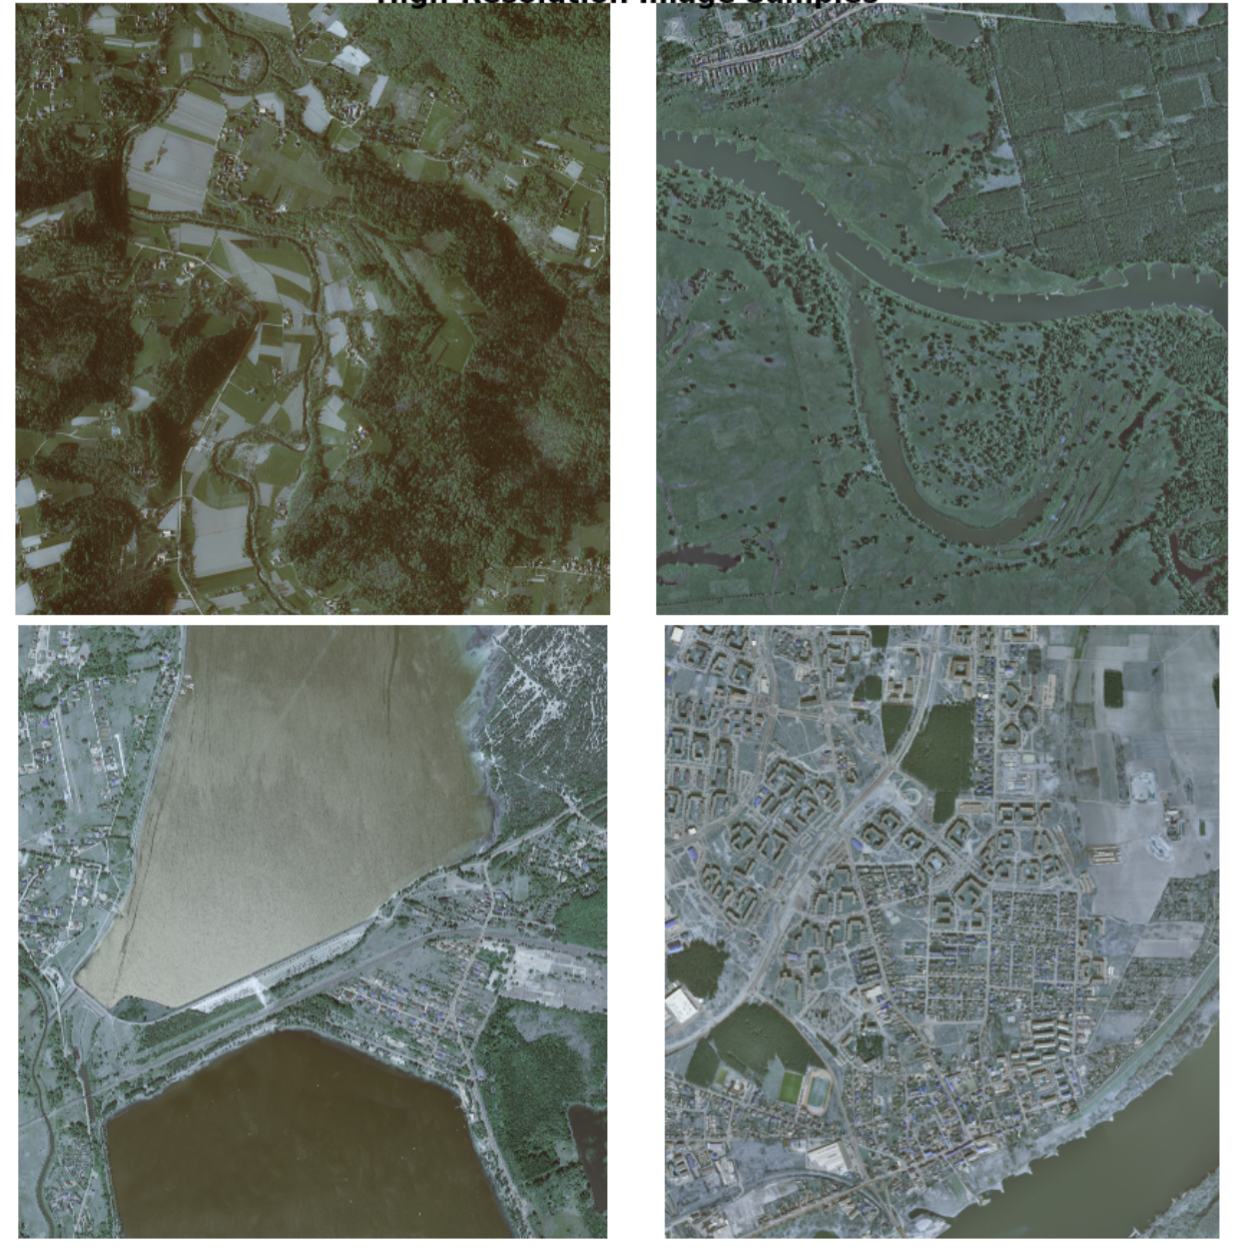
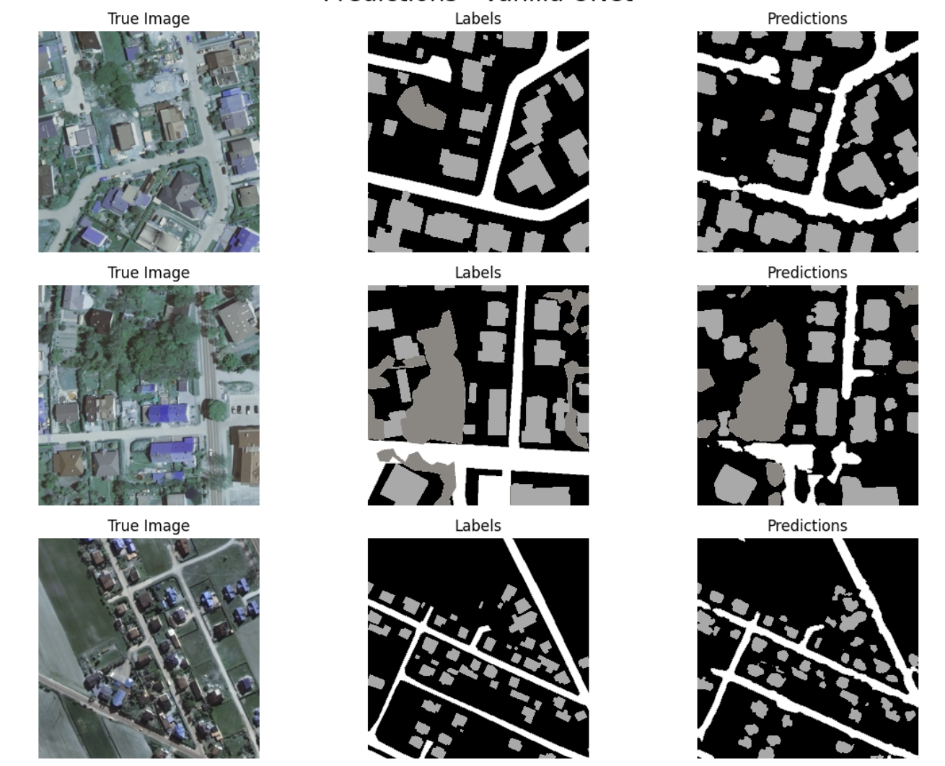
Landcover.ai Satellite Imagery Dataset
216 km sq (25 cm resolution)
Urban pixel ratio = 0.8 %
( 14% at 512*512 patch level)

Slide 4
Core Intuition
-Bottleneck compresses each patch into a compact, information‑rich representation, allowing us to rapidly assess whether it is likely to contain the target class without running the full decoder.
By thresholding minimal computation statistics (channel means) on this bottleneck encoding, we selectively activate the expensive decoder only for patches predicted to hold the region of interest.

Slide 5
Bottleneck‑Gated Segmentation Network (BGS‑Net)
Introduce a gating module at the U‑Net bottleneck that evaluates lightweight feature‑map statistics to decide decoder execution.
End‑to‑End Pipeline
Encode all patches through the U‑Net encoder → bottleneck features
Gate using channel‑mean thresholds on selected bottleneck channels
Conditional Decode only the gated subset of patches; fill others with background

Slide 6

Vanilla Unet -> BGS-Net

Slide 7
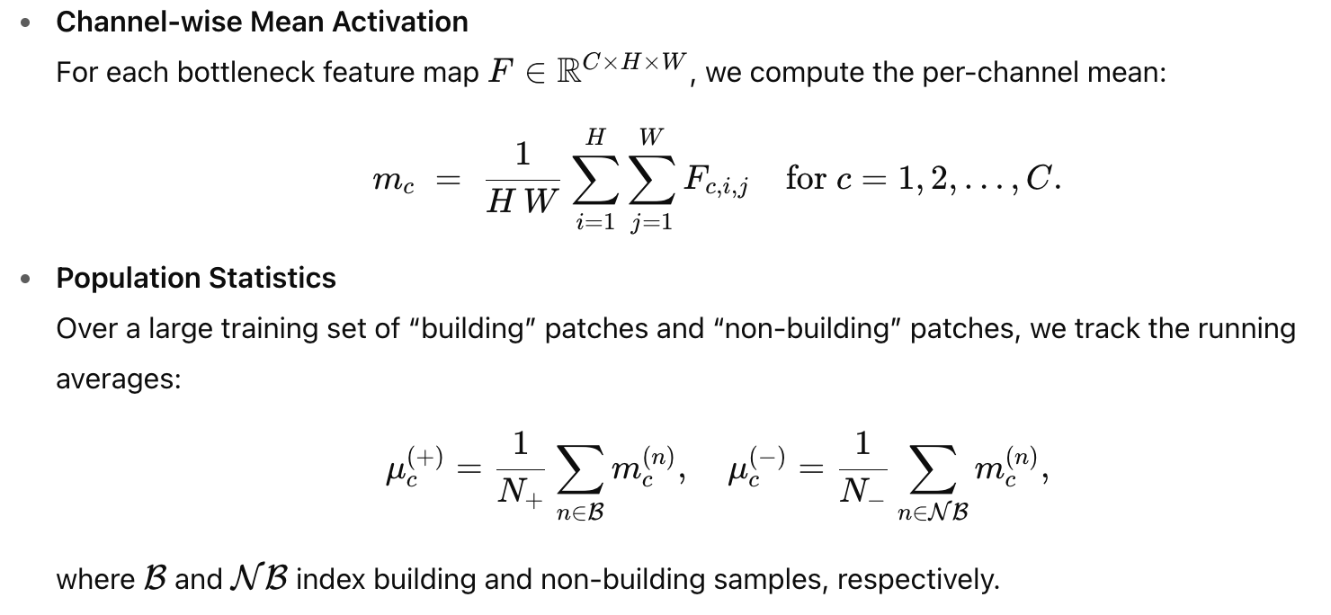
Threshold Determination

Slide 8
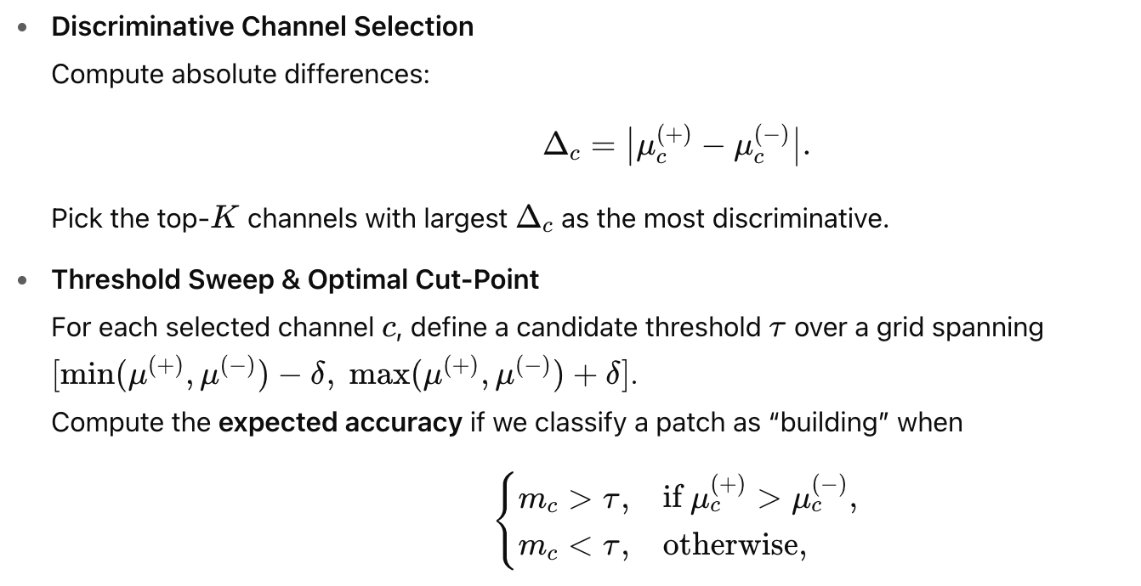
Threshold Determination

Slide 9
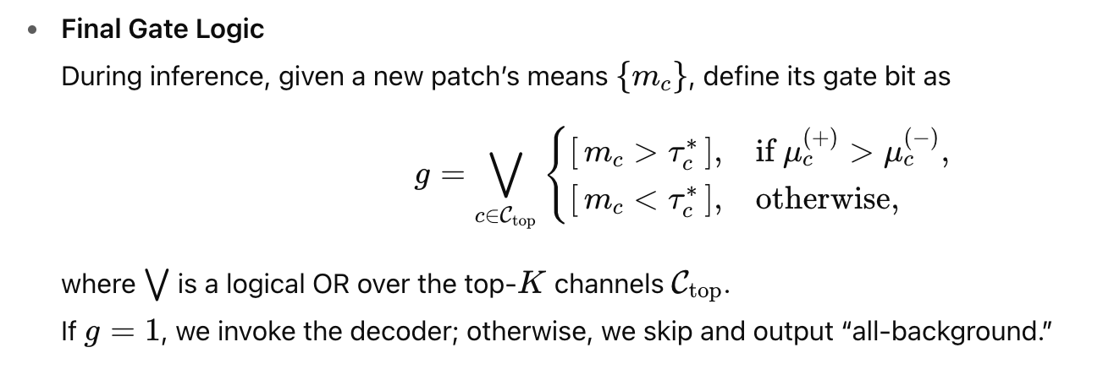
Inference Logic

Slide 10
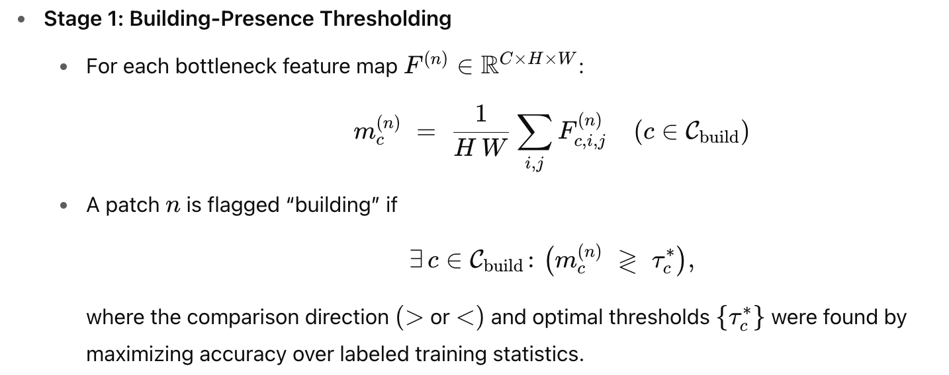
Two Stage Gating

Slide 11
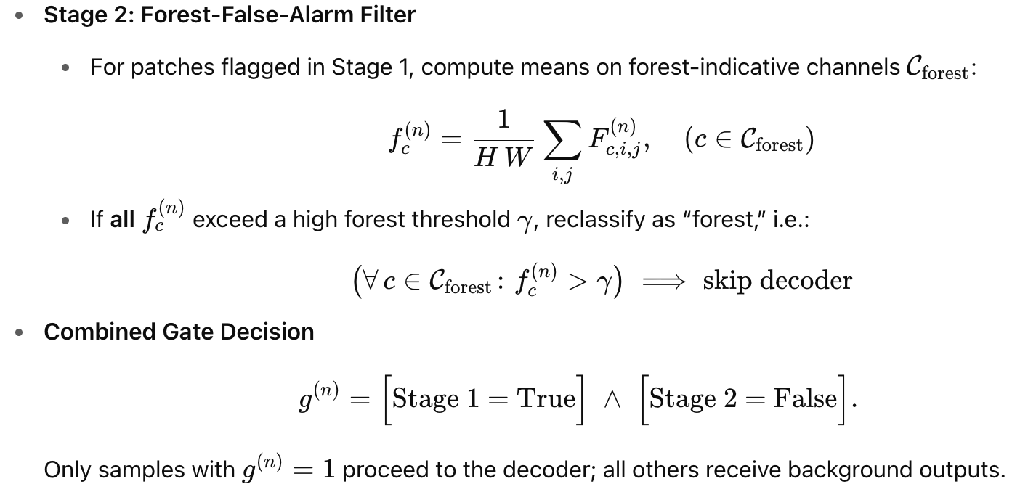
Two Stage Gating

Slide 12
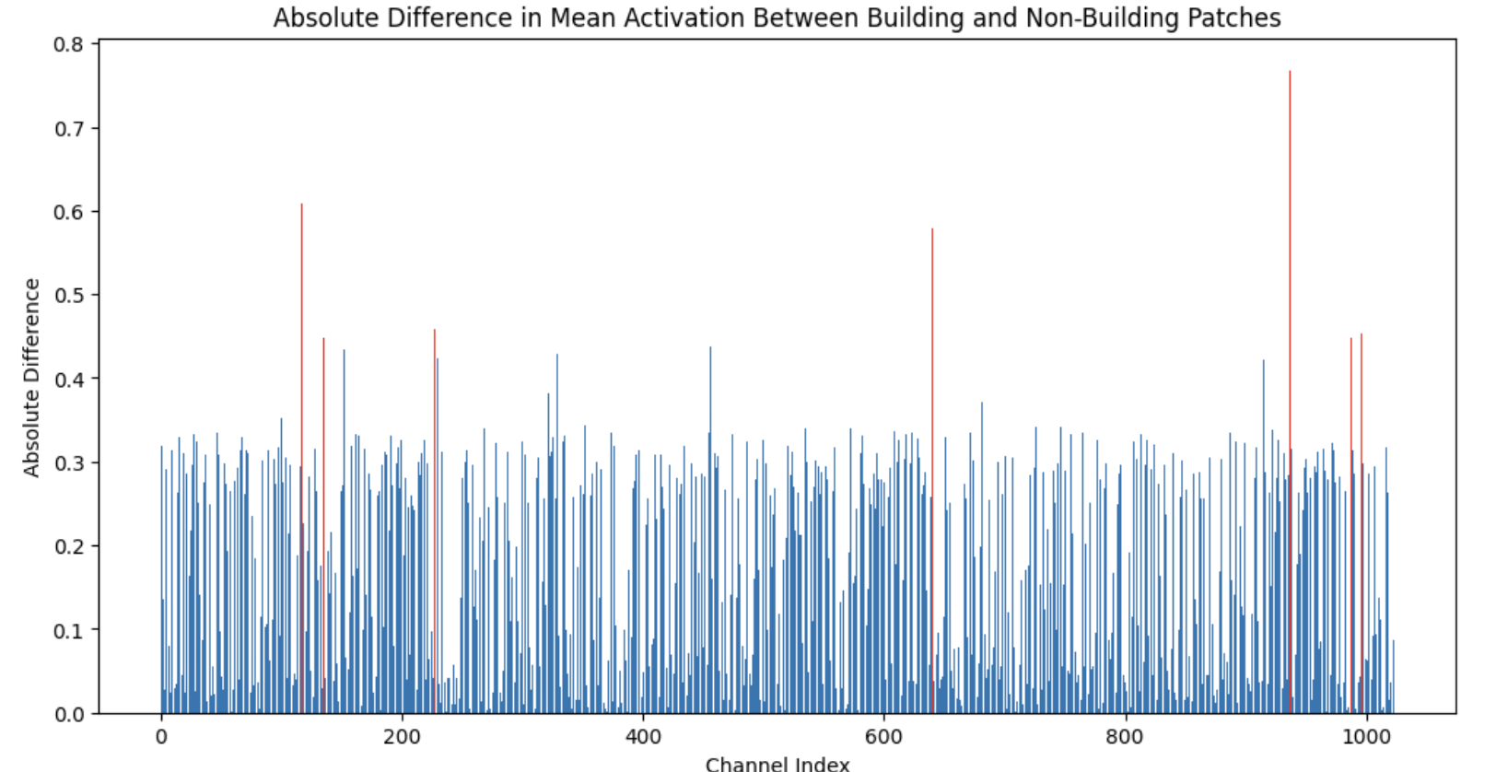
For Landcover.ai Dataset

Slide 13
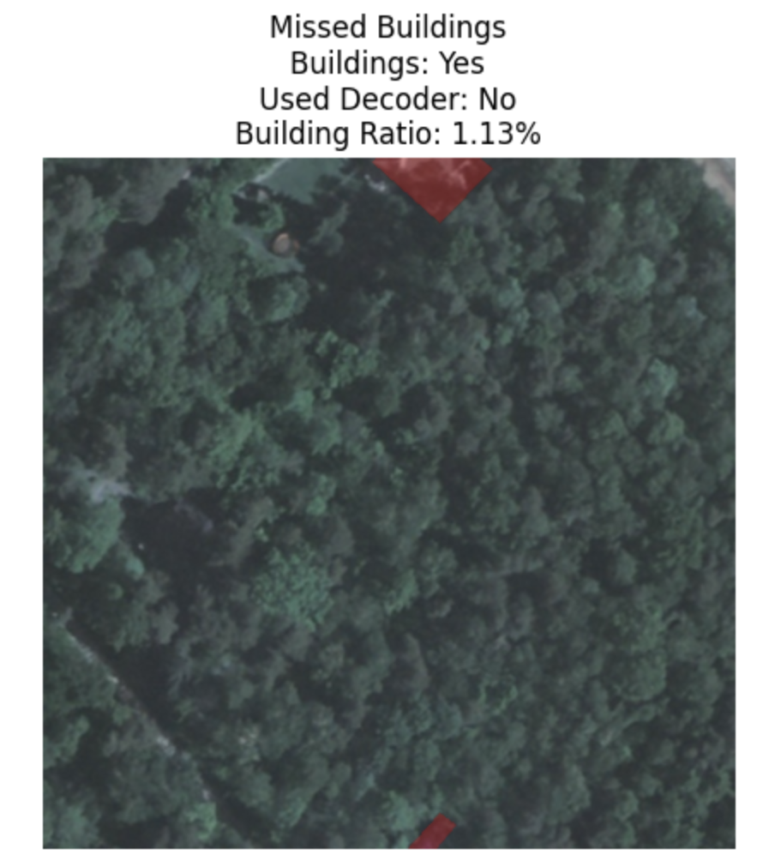
Results
Vanilla Unet (Per Class IoU)
Background: 0.8911
Building: 0.7145
Woodland: 0.8660
Water: 0.8362
Road: 0.5624
BGS-Net
Building IoU (on those patches): 0.6981
Total images processed: 1 602
Images containing buildings: 230
Images where decoder executed: 695 (43.38 %)

Slide 14
Compute Overload Analysis
Channel Mean Calculations:
For each patch: 3 building channels × 32×32 spatial dimensions = 3,072 operations
For forest detection: 6 forest channels × 32×32 = 6,144 operations
Total mean calculations: ~9,216 operations per patch
Total Computational Overhead:
Approximately 9,233 operations per patch (less than 0.001% of decoder computations)
Compared to decoder with few billion operations

Slide 15
Benefits
Separate Encode vs. Decode:
Always execute the lightweight encoder and bottleneck stages on every patch, but invoke the costly decoder only for patches likely to contain targets.
Same Quality Segmentation For ROI (Over methods like knowledge distillation)
No Full‑Model Retraining Required
Negligible Inference Overhead
Superior to Trainable Early‑Exit Mechanisms (Unlike multi‑exit segmentation networks)
Top with existing methods

Slide 16
2​​×Cin​×Cout​×K2×HWops
for features [512,256,128,64][512,256,128,64][512,256,128,64]
54 fi2{_i}^{2}i​2Hi{_i}i​Wi{_i}i​
16fi2​Hi​Wi​

Slide 17
Encoder Path (Always Executed)
Series of convolutional blocks with downsampling
Each block contains:
Two 3×3 convolutional layers with BatchNorm and ReLU
MaxPooling for downsampling
Feature dimensions typically follow a pattern like [64, 128, 256, 512]
Skip connections are stored for later use in the decoder
Bottleneck (Always Executed)
The deepest part of the network
Double convolution with the highest number of features (e.g., 1024)
Contains the most compressed representation of the image

Slide 18
Conditional Decision Logic
Analyzes specific channels in the bottleneck features
Calculates mean activation for key channels (e.g., channels 937, 117, 640)
Compares activations against pre-determined thresholds
Uses a second filter to identify forest false alarms
Decides whether each image in the batch needs decoder processing
Decoder Path (Conditionally Executed)
Only runs for images containing buildings
Series of upsampling blocks with skip connections
Each block contains:
Transposed convolution for upsampling
Concatenation with corresponding skip connection
Two 3×3 convolutional layers with BatchNorm and ReLU
Feature dimensions decrease back down (e.g., 512→256→128→64)
Output Layer
For images with buildings: full segmentation from decoder output
For images without buildings: simplified output with background class only
1×1 convolution to produce final class probabilities
Output dimensions: [batch_size, num_classes, height, width]

